Slide 1
A Brief Look at the Early History of Computers
Making Switches and Some History
© 2018 L. V. Kale at the University of Illinois Urbana-Champaign.

Slide 2
How to Make Switches
Use mechanical power
Use hydraulic pressure
Use electromechanical switches (electromagnet turns the switch on)
Current technology:
Semiconductor transistors
A transistor can be made to conduct electricity depending on the input on the 3rd input
CMOS “gates” (actually, switches)

Slide 3
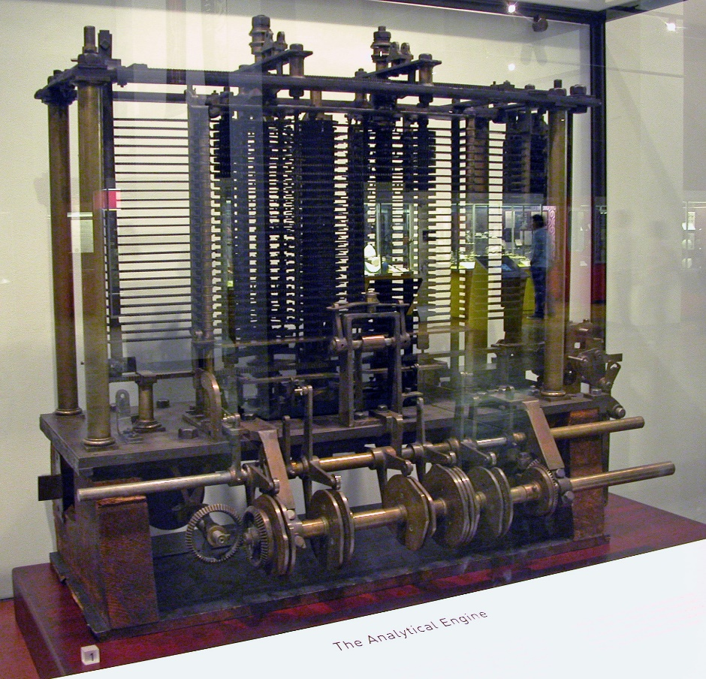
Some History: Analytical Engine
In 1837(!) Charles Babbage designed (but not built) the first machine that is close to a modern computer
Ada Lovelace, daughter of Lord Byron, has been called the first programmer for this machine
Mechanical computer
(Barral, 2009)

Slide 4
Some History: Continued
Konrad Zuse (1941, in Germany) built Z3
Electromechanical
Lacked conditional branches but could do loops
1940: Alan Turing helped design Bombe for decoding German messages, but it wasn’t a full-fledged computer
World War II led to modern designs based on vacuum tubes as switches
Colossus Mark I (1943)
ENIAC (1946): first modern programmable computer
1945-46: Designs for general purpose stored-program computer:
Alan Turing designed ACE and von Neumann designed EDVAC

Slide 5
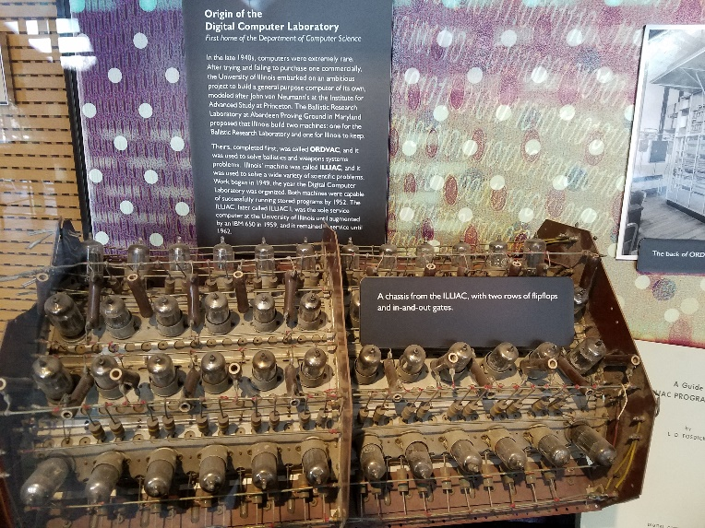
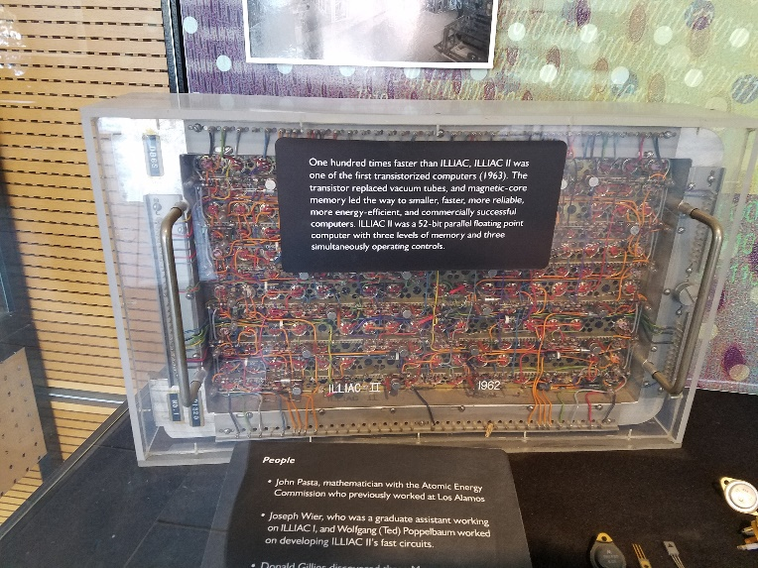
Some History: Continued
1951: ILLIAC I: First academic computer at Univ of Illinois
You see parts of it in a showcase in my department’s atrium
1955 onwards: Vacuum tubes were slowly replaced by transistors
A chassis from ILLIAC I with vacuum tubes
A board from ILLIAC II with transistors

Slide 6
Some History: Microprocessors
1960s: Integrated circuits: engineers were able to put multiple switches (transistors) on a single chip
1971: First microprocessor, Intel 4004
An entire CPU on a single chip, albeit a 4-bit processor
1972: 8008
1974: 8080
1978: 8086
What happens over the next 30 years is a fascinating story, and one that has consequences for our objective of learning how to write fast parallel programs
Notes:
End video here.. What happens over the next 30 years is a fascinating story, and one that has consequences for our objective of learning how to write fast parallel programs.

Slide 7
References
Barral, B. (ByB). (2009). AnalyticalMachine Babbage London.jpg [Online image]. Retrieved from https://commons.wikimedia.org/w/index.php?curid=6839854

